Slide 1
Camera System to Monitor Residential Societies Vehicle Activities
PIP2001 Capstone Project
Review-0
Batch Number:208
Under the Supervision of,
Dr.Jothish C
Professor / Associate Professor / Assistant Professor
School of Computer Science and Engineering
Presidency University
Roll Number | Student Name
20211CSE0015 | SAKETH REDDY
20211CSE0203 | SAI VIJAY
20211CSE0139 | MANIKANTA SATYASAI
20211CSE0793 | DILEEP SAGAR
Name of the Program: CSE
Name of the HoD: Dr. Blessed Prince P/Dr. Robin Rohit/Dr.Asif Mohammed H.B
Name of the Program Project Coordinator: Mr. Amarnath J.L & Dr. Jayanthi. K.
Name of the School Project Coordinators: Dr. Sampath A K / Dr. Abdul Khadar A / Mr. Md Ziaur Rahman

Slide 2
Content
Problem Statement
Github Link
Analysis of Problem Statement
Timeline of the Project
References

Slide 3
Problem Statement Number:
Organization: MixORG
Category (Hardware / Software / Both) :Software
Problem Description:: To create an affordable solution of a mobile application and a camera system through image processing to identify and monitor vehicles entering and leaving a residential society passing through the entry/exit gate. Many residential society administrations in India face an impending problem of illegal vehicle parking inside their societies and theft of the vehicles. This issue is not bounded to just vehicles, but also add to other security concerns inside the residential societies.
Difficulty Level: Simple

Slide 4
Github Link
The Github link provided should have public access permission.
Github Link

Slide 5
Analysis of Problem Statement
Technology Stack Components: Front-end Mobile Application.
Software Development: Ensure the development costs are manageable by using open-source tools or low-code/no-code platforms where possible.
Compatibility: The app should support various camera types, including IP cameras and webcams.
Detection: Implement algorithms to detect and recognize vehicles, distinguishing between authorized and unauthorized ones.
Tracking: Track vehicle movements within the society, including entry and exit points.
Notifications: Implement a notification system for real-time alerts about suspicious or unauthorized vehicle activity.

Slide 6
Analysis of Problem Statement (contd...)
Software Requirements:
Frontend Software:
Development Tools:
Android Studio (for testing Android versions).
Xcode (for testing iOS versions).
Libraries/Modules:
React Native (for building the mobile app).
Flutter (UI Toolkit for building the mobile app).
Xamarin (build cross-platform apps using C# and .NET).

Slide 7
Analysis of Problem Statement (contd...)
Backend Software:
Node.js: Server-side language for building scalable backend services.
Django:Python web framework that encourages rapid development and design.
Ruby on Rails: Web application framework written in Ruby that provides default structures for a database.
Google Cloud Platform (GCP): Offers services similar to AWS, including Compute Engine, Cloud Storage.
Microsoft Azure: Provides cloud services such as virtual machines, SQL databases, and app services.

Slide 8
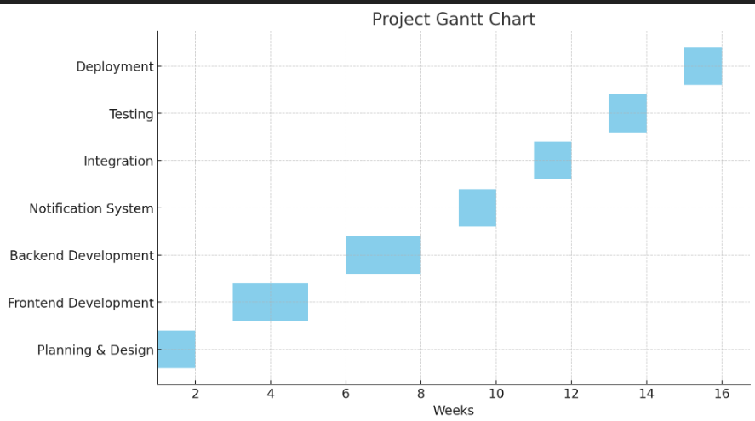
Timeline of the Project (Gantt Chart)

Slide 9
References (IEEE Paper format)
A. Alhaj, D. Skillicorn, and I. Wagner, "Intelligent Vehicle Monitoring and Detection System," IEEE Transactions on Intelligent Transportation Systems, vol. 19, no. 7, pp. 1989-2000, 2018.
Available: IEEE XploreUse the below link for various APA styles :

Slide 10


